Slide 1
Revision
http://www.youtube.com/watch?v=wjh10kj9Y64

Slide 2
Revision
What is it?
Why do it?
The Space/The Stuff
The Routines
How can I do it?
Practice Practice Practice

Slide 3
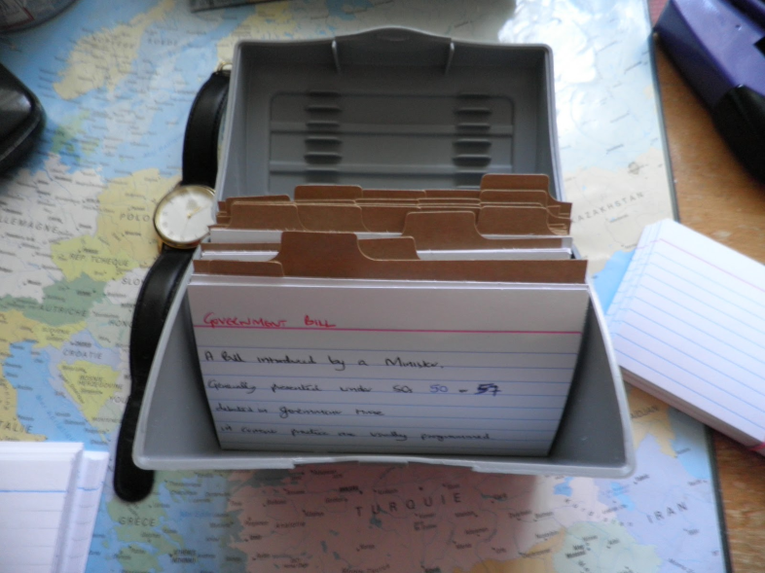
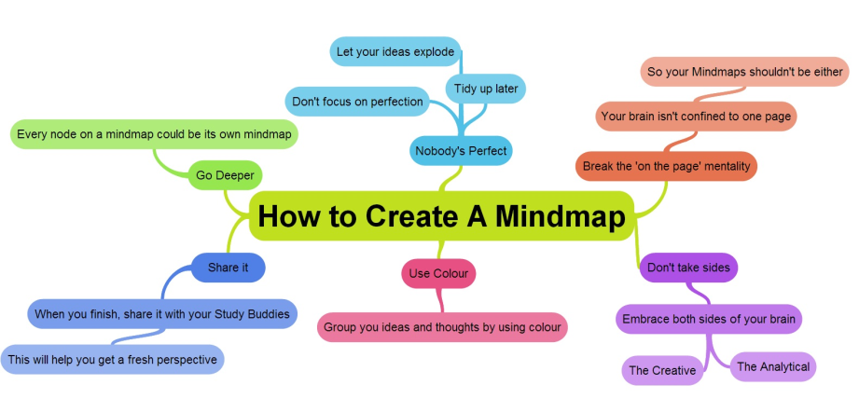
Revision

Slide 4
What is it?
Helping your brain remember what it needs to know for the exam.
Aim is to learn your subjects so that a key word will allow your brain to unlock all the other things you know about that subject.

Slide 5
Why Do It?

Slide 6
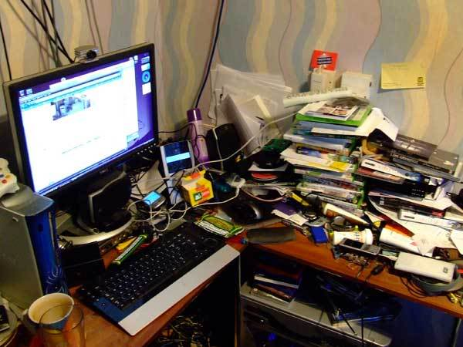
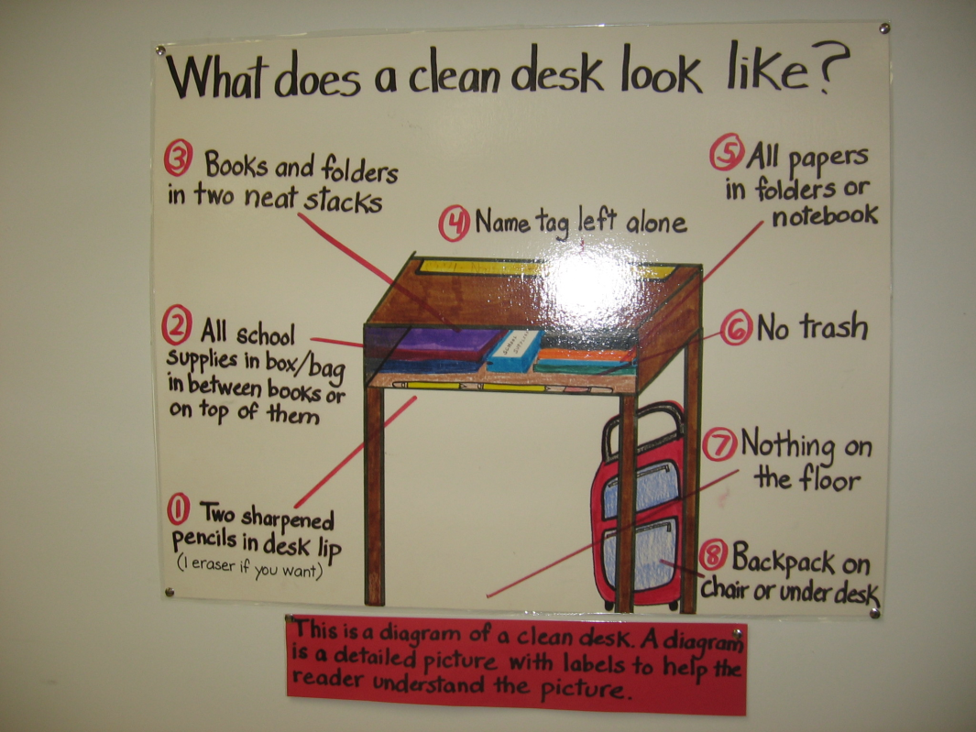
The Space Where would you learn best?

Slide 7
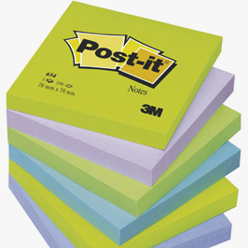
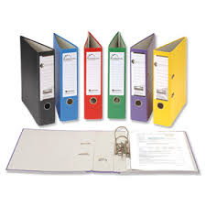
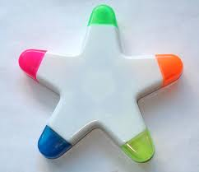
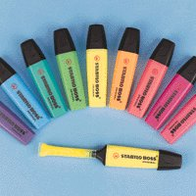
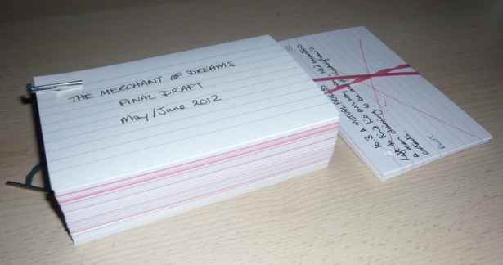
The Stuff

Slide 8
The Routines
 | Mon | Tue | Wed | Thur | Fri | Sat | Sun
4-5 | Maths | Go out | English | Maths |  | Maths | Maths
5-6 | Geog | Go out | Maths | History |  | History | English
6-7 | Tea | Tea | Tea | Tea | Tea | Spanish | Geog
7-8 | Spanish | Maths | Geog | English | Go out | Go out | Maths
8-9 | Go out | History | Spanish |  | Go out | Go out | History
9-10 | Go out | Science | Early finish |  | Go out | Go out | Science
Take Breaks/Sleep Well/Eat Well

Slide 9
Revision

Slide 10
How Can I Do It?
Revision cards
Mind Maps
Post It Notes
Memory Tests
Highlighter Pens
Revision Guides
Don’t Just Read?

Slide 12
Review
After an hour
After a day
After a week
After a month
Then it will stick

Slide 13
Learning is doing.....
Research shows that as learners we take in:
10% of what we read
20 % of what we hear
30 % of what we see
50 % of what we see and hear
70 % of what we ourselves say
90 % of what we ourselves do

Slide 14
Practice
Exam Questions
Get friends to test you
Test yourself

Slide 15
Part One
Reading for meaning, Improving note taking and remembering it!

Slide 16
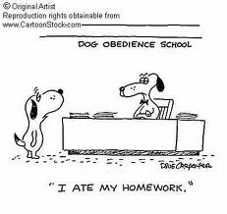
IMPROVE YOUR NOTETAKING
In this first session, we want you to know how to
RECORD
REDUCE
RECITE
REFLECT
REVIEW
We’ll do this by highlighting, mind maps, revision cards and post it notes.
Notes:
Record: During the lesson, record the important facts and ideas.
Reduce: As soon after as possible, summarize the facts and ideas. Summarizing clarifies meanings and relationships, reinforces continuity, and strengthens memory.
Recite: Cover your notes. Go over the facts and ideas of the lesson as fully as you can. Then, verify what you have said by looking at your notes.
Reflect: Draw out opinions from your notes and use them as a starting point for your own reflections. Reflection will help prevent ideas from being forgotten.
Review: Spend a few minutes every week reviewing your notes, and you will retain most of what you have learned.

Slide 17
Reading for meaning
Reading for meaning: scan the material to get an idea of what parts you will need to study in detail.
Read: The material from beginning to end – highlight the key areas/words/points.
Recite: What you have read, if necessary make brief notes of main ideas and important details – Mind Map
Review: What you have read and test the accuracy of your memory – Ask 5 questions
Test: After few days, test yourself on what you had read.

Slide 18
Task One READING For meaning – 3 minutes How plants use glucose
Take one section each.
Using the material, scan the document for the most important areas
Read more carefully and highlight key words, phrases, definitions
(you could highlight in one colour the key words and in another colour, the facts)
The following slide gives you an example.

Slide 19
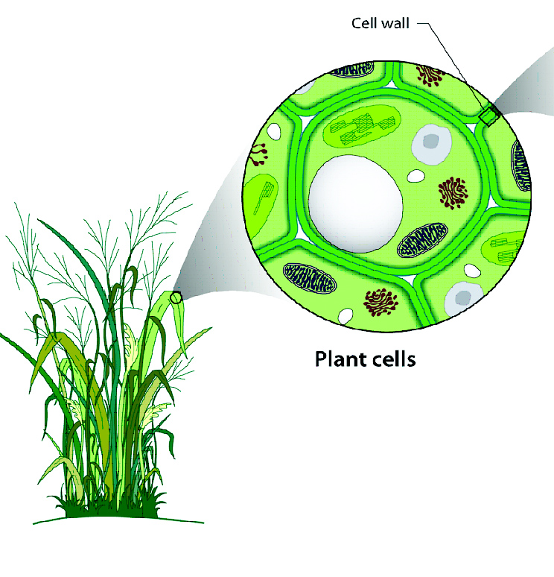
CELLULOSE
Glucose is converted into cellulose for making cell walls, especially in a rapidly growing plant.
The cell wall is the tough layer that surrounds plant cells.
It is located outside the cell membrane and provides cells with structural support and protection.
They allow plants to grow tall without any other support.
A very important function of the cell wall is to act as a pressure vessel, preventing over-expansion when water enters the cell by osmosis.

Slide 20
Mind Maps can come in all sorts of shapes, sizes and colours, some even come with pictures
Task Two
Now you have to work out how to learn this information. It helps if you present it in a way it is easy to learn from – 10 minutes

Slide 21
A simple mind map

Slide 22
A Simple Mind map but with pictures

Slide 23
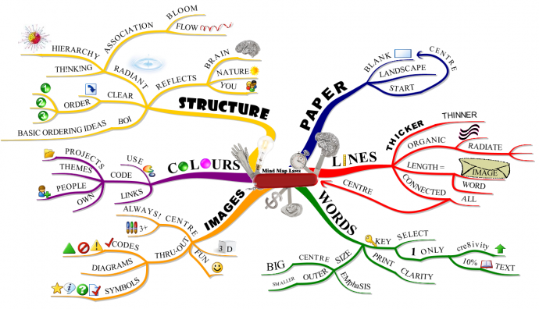
A little more complicated

Slide 24
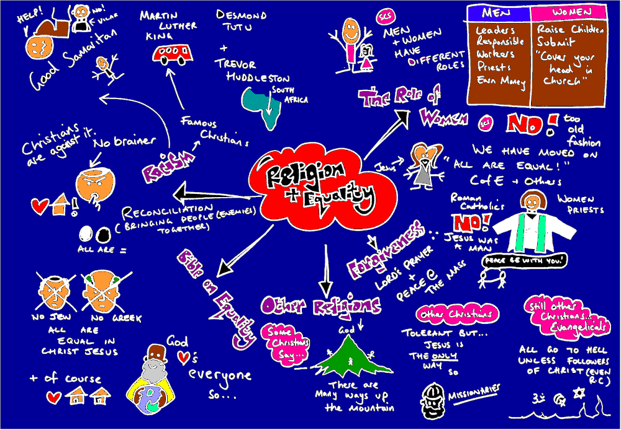
A little more visual

Slide 25
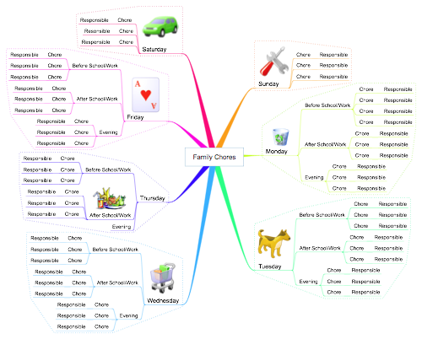
A very structured Mind map

Slide 26
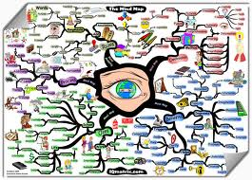
And lastly, an explosion!

Slide 27
Task Two - Now begin to create your own mind map in your groups. Take one section each and create your ‘Big Picture’ mind map using the sugar paper – 10 mins
!Top tips – think colour, pictures, structure.

Slide 28
Task Three: 5 mins Bulking it down even more… Using your mind map and highlighted notes, create a revision card
Top Tips: Using different coloured pens and highlighters will help you to create a useable resource.

Slide 29
Lastly – 2 minutes
Create 5 questions on post it notes about what you’ve just revised.
Stick them somewhere .. The back of the toilet door, on the biscuit cupboard……
Go back to these in a couple of days time to test yourself.

Slide 30
Final Plenary
What do you think are the 5 Top Tips to Revision

